Slide 1

beaR
a new R library from BEA
Jeff Chen, Chief Data Scientist, US Dept. of Commerce
Brendan Leary, Branch Chief, Bureau of Economic Analysis
Andrea Julca, Economist, Bureau of Economic Analysis

Slide 2
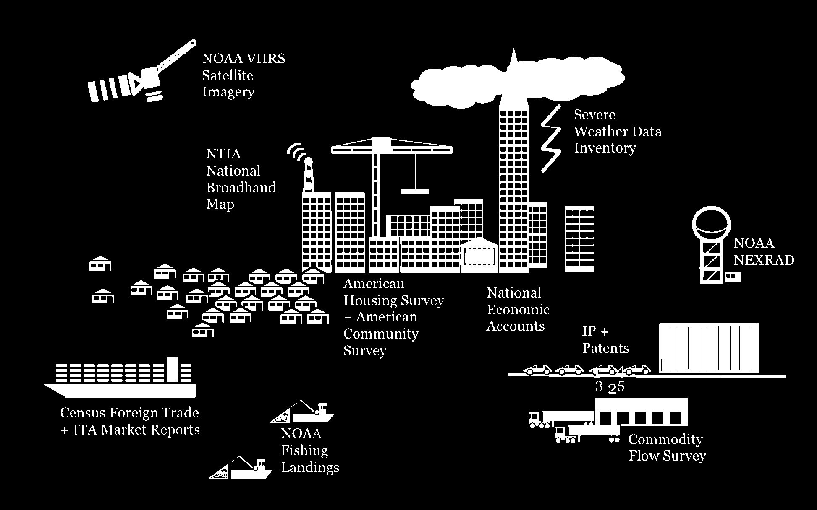
Notes:
[Image of DOC logo]
At the US Department of Commerce, we have many APIs providing access to economic data … patent data.. and weather data .

Slide 3
Notes:
[data scientist connected to everything]
We believe that data scientists everywhere should be able to access and use our data to drive impact across society.

Slide 4
Notes:
[API image]
For those who have ever worked with any APIs in the wild, it may take a bit of work to get started.

Slide 5
Notes:
[Data scientist’s user experience curve — ]
And the lack of a clear workflow often means there’ll be a rollercoaster of emotion

Slide 6
EXCITEMENT!
Notes:
[Same diagram pointing at elation]
It always starts with the thrill of getting access to an API.

Slide 7
TROUGH OF SORROW
Notes:
[Same diagram pointing at trough]
Then, there is a trough of sorrow due to relentless syntax errors, inability to discover data, lack of documentation. But then once the data starts flowing, you may still use Stack Overflow as a crutch…

Slide 8
RECOVERY TO SUCCESS
Notes:
[Same diagram point at recovery]
Until you get somewhere. It’s a true story.

Slide 9
TEDIUM.
TEDIUM.
TEDIUM?
Notes:
[Tedium!!]
You can feel the tedium, can’t you?

Slide 10
Notes:
[BEA Solution]
Well, here at Commerce, we don’t believe that should ever happen. We believe that a data-driven economist, statistician, or data scientist should be able to get started with our data at lightning pace. And the Bureau of Economic Analysis is leading the charge.

Slide 11
Notes:
[BEA R Library]
Today, we’re happy to announce a new R statistical programming library designed to access economic data from the BEA API. We call it BEA R. This soon-to-be released open sourced library was developed by BEA economist Andrea Julca as part of the Commerce Data Service’s In-Residence Incubator program and is now part of BEA’s developer program.

Slide 12
user
experience
time
Navigate
Get
Manipulate
user
workflow
Notes:
BEA supports 12 distinct APIs covering over 13,000 data series on the US economy. Which is the right data for me? Well, we’ve boiled down a workflow into three basic steps to help you hone in on the right data.

Slide 13
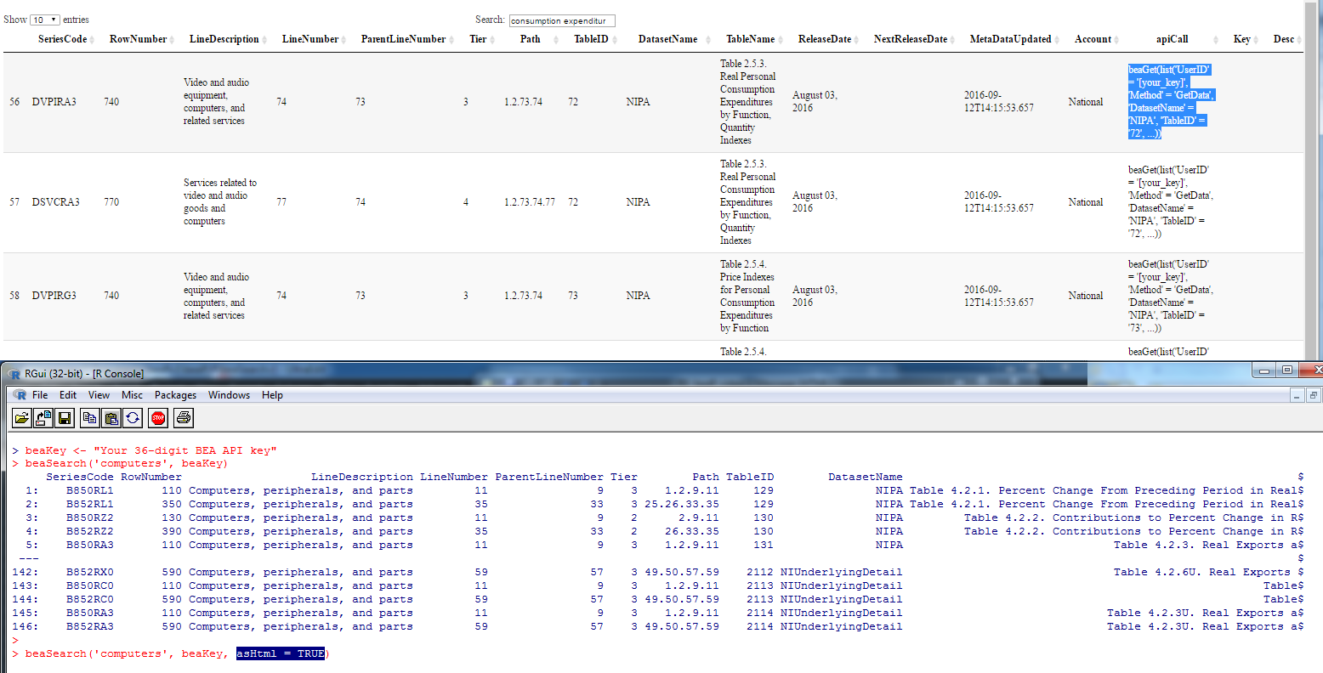
NAVIGATE
beaSets()
beaParamVals()
beaSearch()
Navigate
Get
Manipulate
Notes:
With three basic functions, you can now easily search for the right data series and get example code to extract that data.

Slide 14
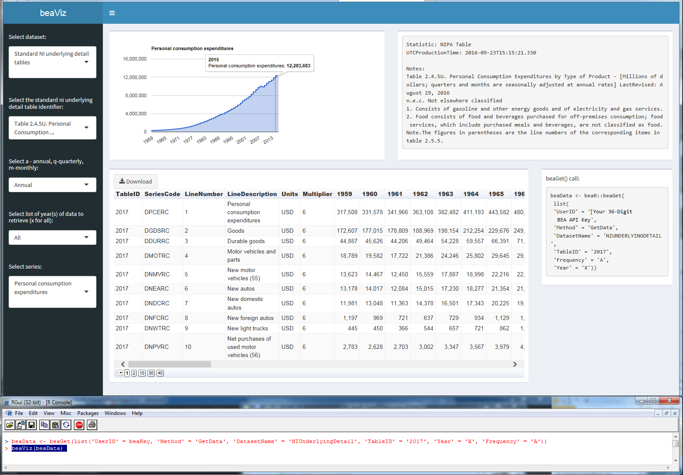
GET/VIEW
beaGet()
beaViz()
Navigate
Get
Manipulate
Notes:
For a graphical search alternative, the library comes with an exploratory dashboard and query generator to help visually discover the data series you need.

Slide 15
Year | Qtr | Val
2000 | 1 | 12
2001 | 1 | 14
2002 | 1 | 22
2003 | 1 | 26
2004 | 1 | 38
2005 | 1 | 34
. . . | 1 | 46
1 | 2 | 3 | 4 | 5
Year | 2000 | 2001 | 2002 | 2003
Qtr | 1 | 1 | 1 | 1
Val | 12 | 14 | 26 | 38
MANIPULATE
bea2List()
bea2Tab()
Navigate
Get
Manipulate
Notes:
Then, once you find the right data series, bea R will help you transform the data into the right format so you can get right into visualizing trends or produce economic forecasts.

Slide 16
Which is the Awesomest Choice?
✓
Notes:
Imagine being able to master 400+ tables with 13,000 series on national economic accounts in minutes. Fwriting hundreds of lines of code and spending hours to get started. With bea R, the process now takes less than 10 minutes. Which would you choose?

Slide 17
We’re hiring
github.com/CommerceDataService
github.com/us-bea
Notes:
We’re just getting warmed up with open source products at Commerce. Check out our Github repos. Stay tuned. Get involved.

